Slide 1
12th Annual IMPACT Drag Show

Slide 2
What is IMPACT?
UWW’s LGBTQ* Student Organization
6PM on Tuesdays
tinyurl.com/whitewaterimpact
Insta: @UWWIMPACT
UW-Whitewater IMPACT

Slide 3
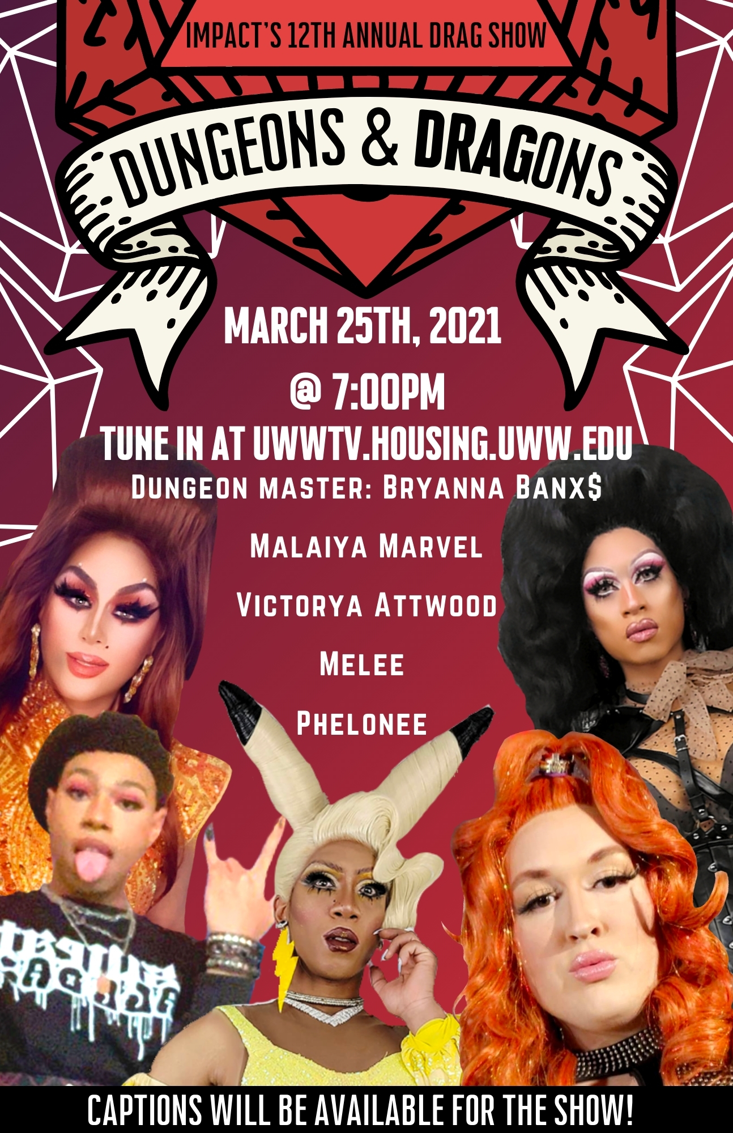
IMPACT’s 12th Annual Drag Show
March 25th
@ 7:00PM
Uwwtv.housing.uww.edu
Or tune in via a TV in the residence halls
Tips will be accepted via a cash app for the queens

Slide 4
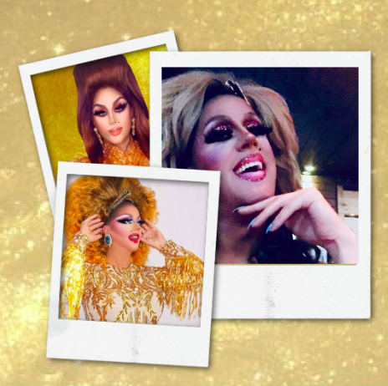
Meet Brianna Banx$
2021 Drag Show Host
Has been in the drag business for 16 years
Held 13 pageant titles
Huge Packers fan!
Facebook: Bryanna Banx
Insta: @closetuwsp

Slide 5
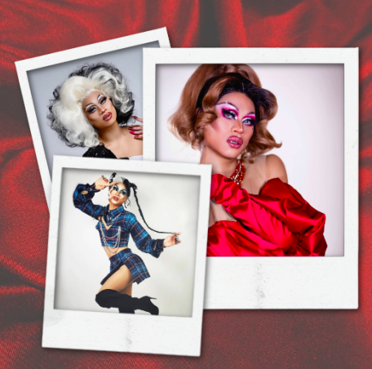
Meet Melee
Recently featured in Cosmopolitan
Insta: @Meleethequeen
Facebook: Melee McQueen
Twitter: @Meleethequeen

Slide 6
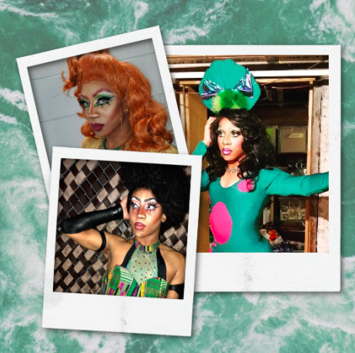
Meet Malaiya Marvel
UWW alumni
Previous resident assistant
Insta: @MalaiyaMarvel
Facebook: Malaiya Marvel
Twitter: @Malaiya Marvel
Podcast: Too Soon?

Slide 7
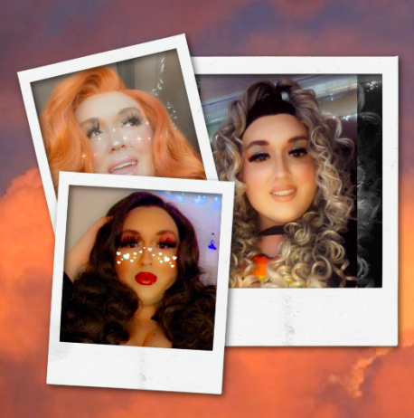
Meet Victorya Attwood
Current 3rd year UWW Student
Pronouns: They/ Them/ Theirs
Involved all over campus!
Currently a resident assistant
Major: Business and Marketing Education Major
Industry: Secondary Education and Student Affairs

Slide 8
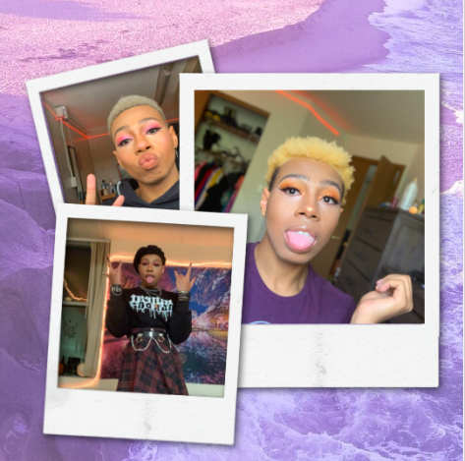
Meet Phelonee
Current 2nd year UWW student
First time performing drag
Current resident assistant
majoring Media Art and Game Design and minoring in dance

Slide 9
IMPACT’s 12th Annual Drag Show
March 25th
@ 7:00PM
Uwwtv.housing.uww.edu
Or tune in via a TV in the residence halls
Tips will be accepted via a cash app for the queens

