Slide 1
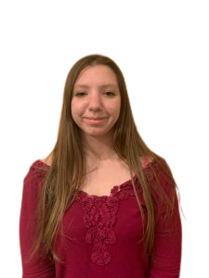
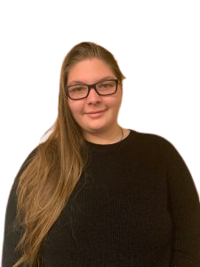
RHA Co-Programmers
Notes:
Amanda

Slide 2
What we do
Oversee and Facilitate Programming for the Residence Hall Association (6 programs / 2 passive programs a semester minimum
Make fun posters, advertisements, and emails
Work with a budget of between $3,000-5,000 (varying by year)
Swag items
Program Materials
Oversee the Programming Committee and its agendas
Have 2:1’s with the RLA, attend Exec Meetings, create a fun atmosphere at programs
Notes:
Becca -- 1, 2, 3
Amanda -- 4, 5

Slide 3
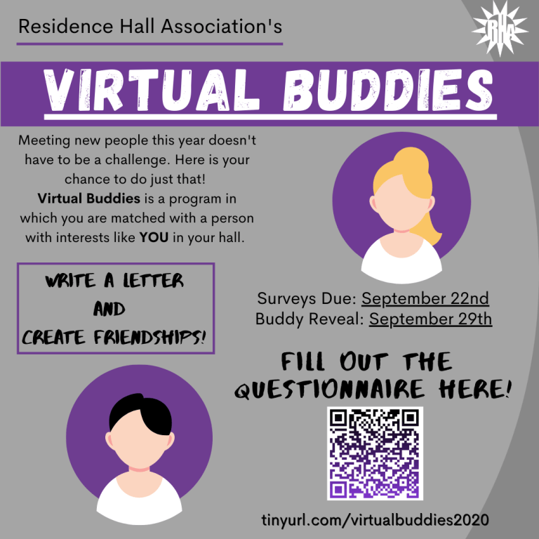
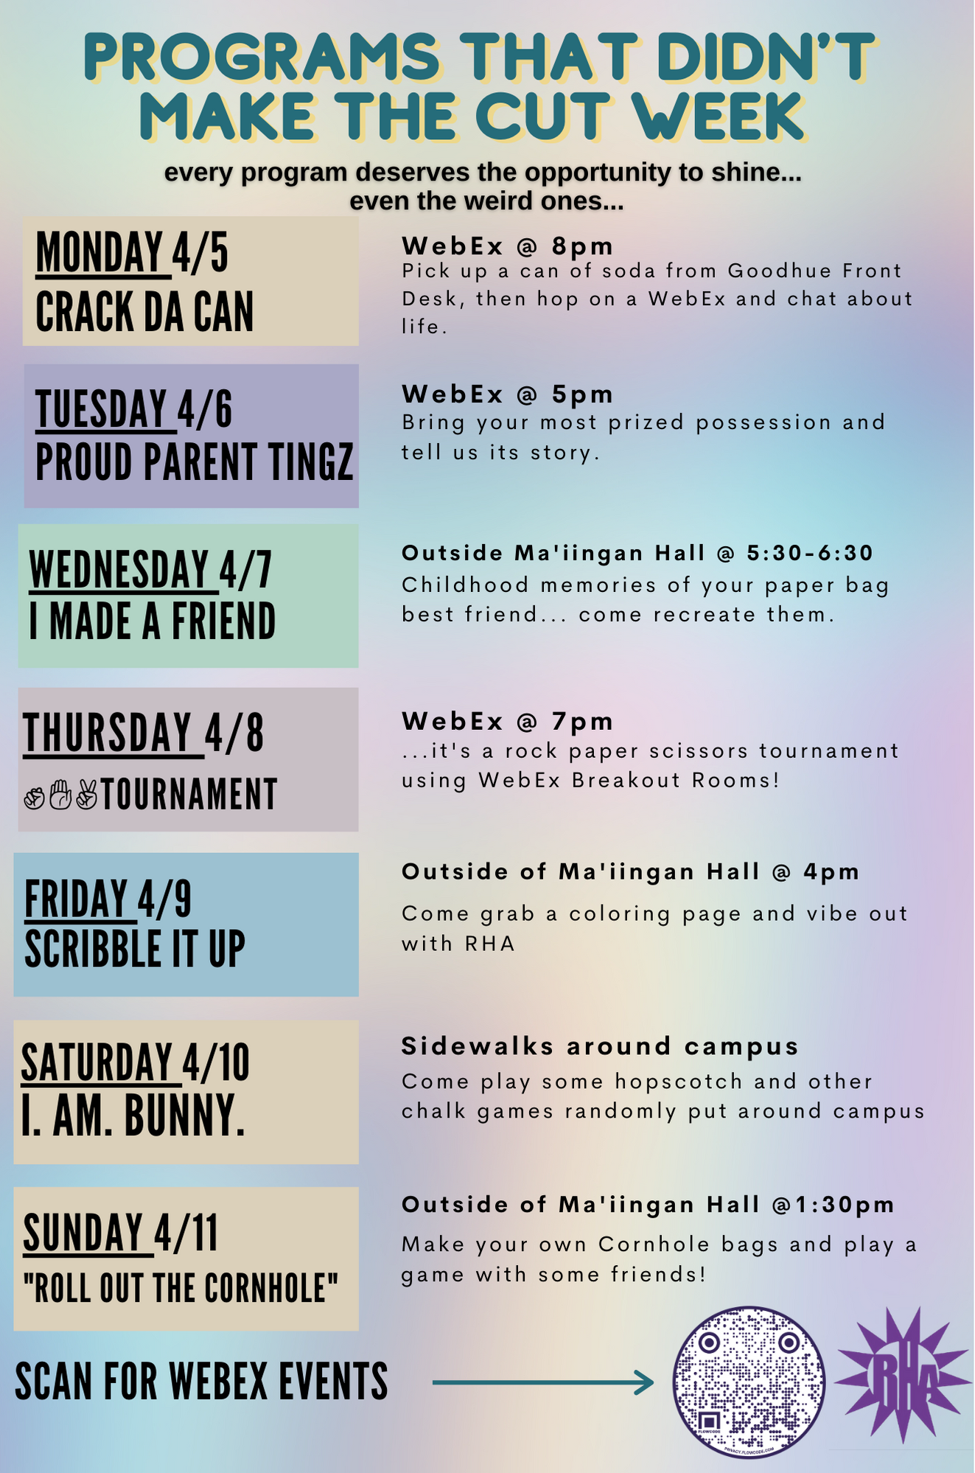
Notes:
Becca

Slide 4
GLACURH Program of the Year 2020
Able to win awards
Get recognized nationally
Notes:
Amanda

Slide 5
“How has this position helped me grow?”
Amanda:
Learned speaking and presenting skills
How to lead a team better
I learned to have fun while getting work done
Becca
Became more comfortable speaking in front of others
How to lead a team better
Notes:
Both

Slide 6
POSITIVES OF THE ROLE
Amanda
Teamwork Opportunities
I became so close with my Co
Found a creative outlet
Learning how to communicate effectively
There are so many laughs and it’s always fun
There is so much support
Becca
Getting to see a community build
Being able to be creative and bounce Ideas off each other
Become close with the other Co
You can be as creative as you want
You can not be wrong with ideas
Notes:
Both

Slide 7
How does this differ from LIT Programming?
Becca
You make programs for the entire campus
A bigger budget to do more
Notes:
Becca

Slide 8
Why should I apply?
Amanda
Put on large scale programs for the campus community
Work with an amazing team of people
Able to be creative in multiple ways
Gain lifetime skills
Notes:
Amanda

